Slide 1
Rural Broadband Issues for Tribal Nations and the Developing World
2016 Broadband Communities Summit
Austin, Texas

Slide 2
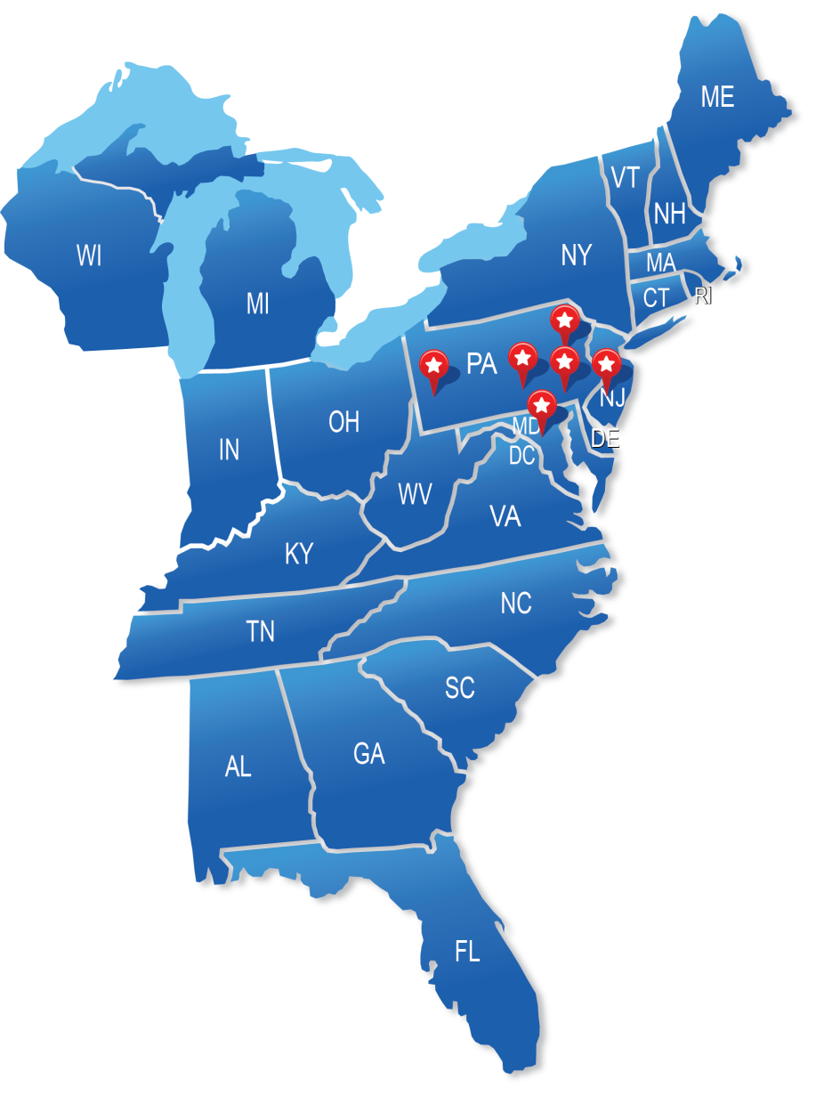
Advantage Engineers
Telecommunications
Headquarters
Baltimore/D.C. Metro Area:
7070 Samuel Morse Dr., Ste 150
Columbia, MD 21046
443-367-0003
Environmental & Geotechnical
Headquarters
Central Pennsylvania:
435 Independence Ave., Ste C
Mechanicsburg, PA 17055
717-458-0800
Central New Jersey:
520 Fellowship Rd., Ste A-106
Mount Laurel, NJ 08054
Philadelphia Area:
1025 Andrew Dr., Ste 100
West Chester, PA 19380
Greater Lehigh Valley:
6520 Stonegate Dr., Ste110
Allentown, PA 18106
Pittsburgh/Ohio Area:
2400 Ansys Dr., Ste 102 Canonsburg, PA 15317

Slide 3
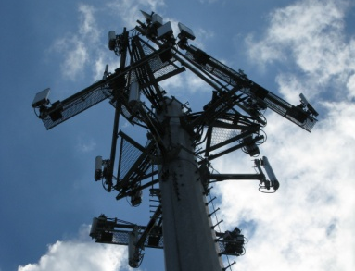
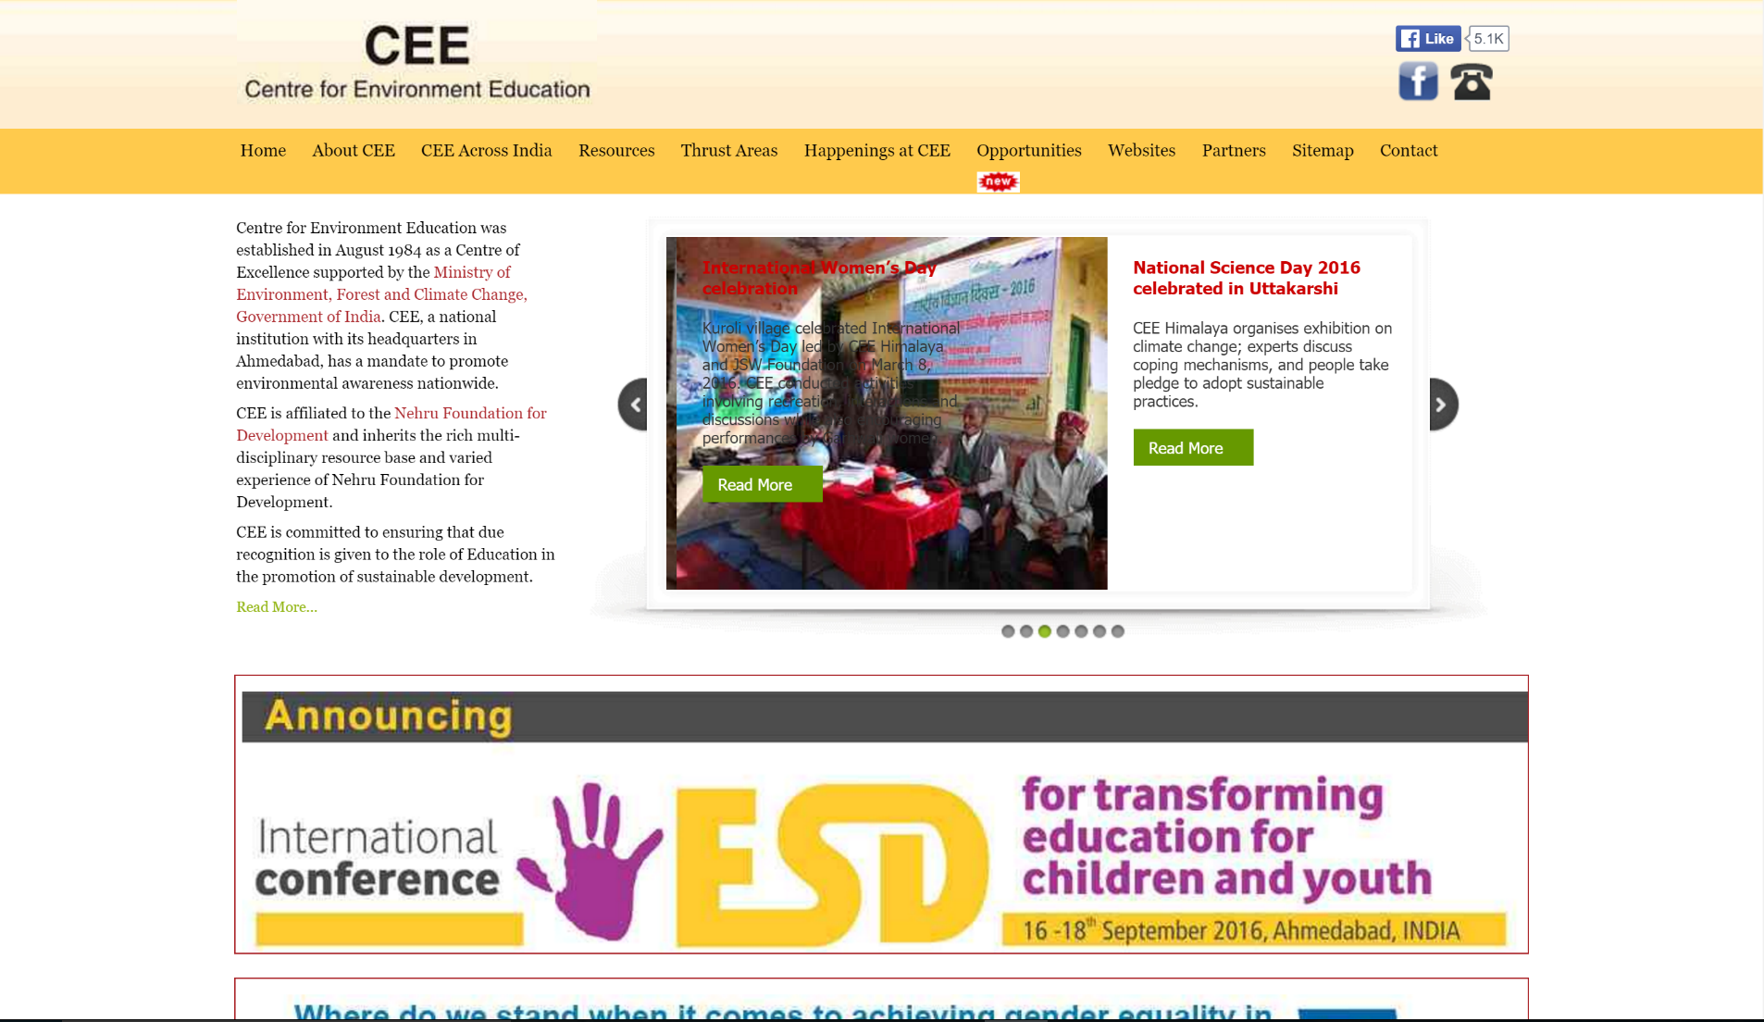
Technology in India

Slide 4
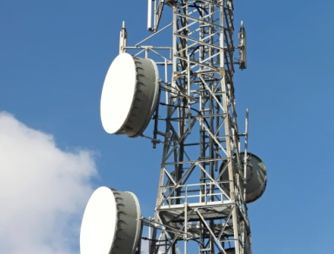
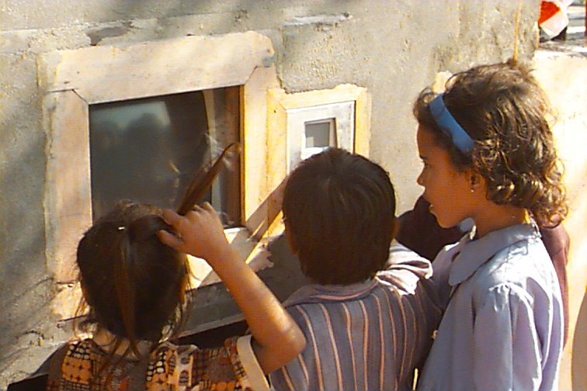
ICTs in India
Hole-in-the-Wall
Photo Credit: Apass Educational Group, LLC

Slide 5
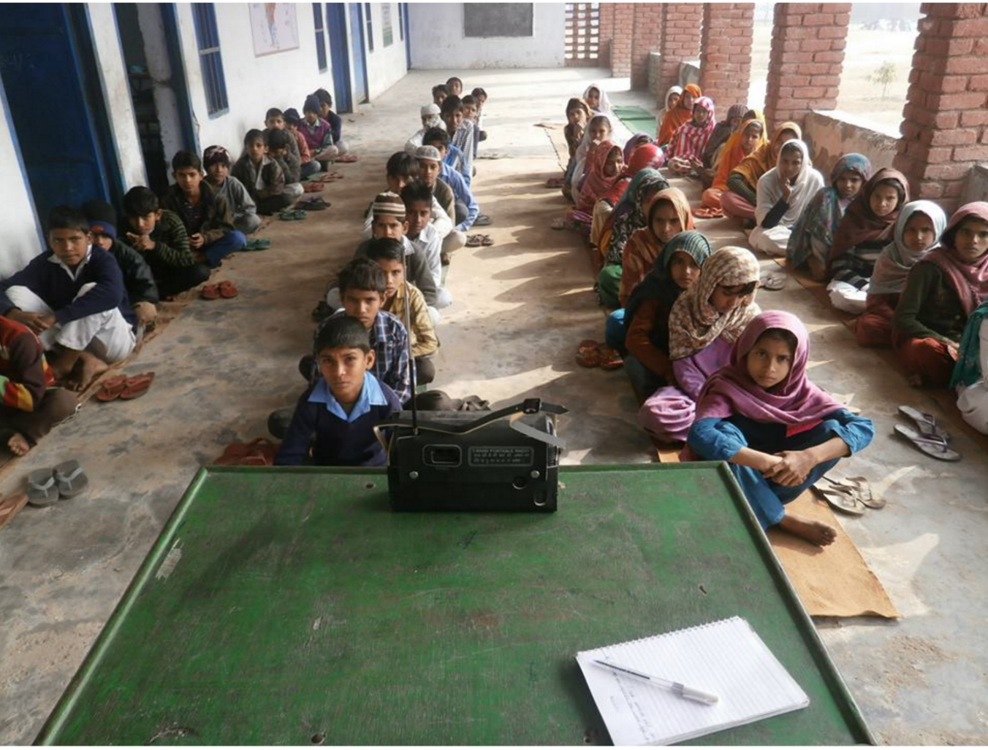
ICTs in India
Community Radio
Photo Credit: The Better India

Slide 6
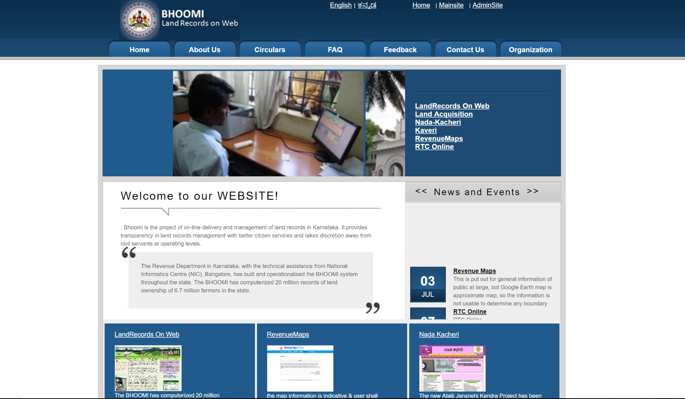
ICTs in India
On-Line Records Management System

Slide 7
Connection Between Broadband and Sustainable Growth
Terms I DIDN’T Hear:
Broadband
Fiber
Digital Literacy
Technology
Economic Development
Terms I DID Hear:
Growth
Progress
Opportunity
Empowerment
Innovation

Slide 8
Contact
Julia Pulidindi
Advantage Engineers
jpulidindi@advantageengineers.com
240-401-3270
www.advantageengineers.com

