Slide 1
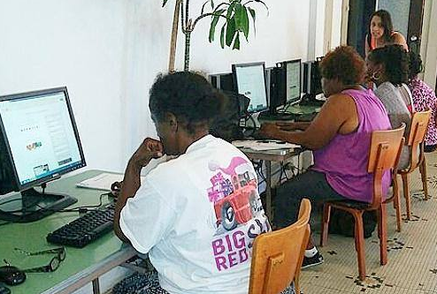
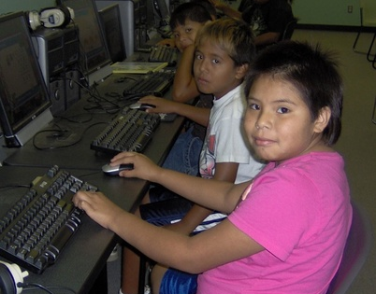
Urban Lessons g Rural Opportunities
Michael Liimatta

Slide 2
My Journey
Lutheran pastor in Michigan
Street outreach & treatment center director
Education director for association of homeless missions
Founder and CAO of an online university
Founder of Connecting for Good, KC Digital Inclusion Coalition
Manager of ConnectHome at HUD in DC
Street outreach & homeless shelter director

Slide 3
2011: Google Fiber Comes to Kansas City
The advent of super high speed Internet threatened to widen the digital divide
The company’s initial low income strategy put up more barriers
Without a community response, half the community – low income residents, minorities and recent immigrants – would not benefit
Response #1: Connecting for Good
Response #2: Kansas City Coalition for Digital Inclusion

Slide 4
ConnectHome: My DC Experience
White House/HUD initiative in 27 Cities & Choctaw Nation of Oklahoma
Pilot to demonstrate effectiveness of public/private partnerships to bring connectivity & devices to school children in public housing
It’s not as easy as it might seem…

Slide 5
Lesson # 1: “If you build it…”

Slide 6
Lesson #2: Solutions Start w/ Data
No one begins to lay fiber before an engineering study is conducted
For highest impact: understand the needs and focus on areas where they are the greatest
Community “buy in” is absolutely essential: They may have a completely different idea of what they need than we do

Slide 7
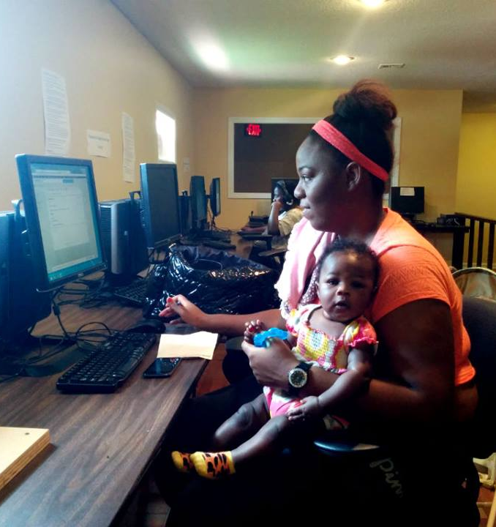
Lesson #3: Not Just One Digital Divide
Early Adopters
The Uninformed
The Financially Challenged
The Unconvinced

Slide 8
Lesson #4: Empower Digital Champions
To reach a community discover who your allies are and identify and empower local advocates
People more readily accept instruction and advice from those who look like them and have a shared life experience
Developing these types of relationships takes time
Many subgroups can have their own champions; seniors, educators, government officials, business owners, etc.

Slide 9
Lesson #5: Coalitions Get Results
For maximum impact, identify your partners and act jointly
Allies can be found in all sorts of places
Libraries are at the forefront of digital inclusion and should be included early
All social service efforts achieve more when access to affordable technology is a part of their efforts

Slide 10
Lesson #6: Computers are Available!
The largest hurdle to broadband adoption is the upfront investment in a computer
In the US, millions of perfectly usable computers end up as e-junk
Reuse is better for the environment than recycling
Partner with your local e-Stewards affiliate to collect out-of-service equipment for refurbishing and distribution
Refurbishing efforts can become training and and a volunteer opportunity for local geeks

Slide 11
Lesson #7: Government Involvement
Digital Equity is one of today’s most important social justice issues
We must education our civic leaders and impress upon them the need to make sure everyone is able to access and use the Internet
On March 15, 2017, the City Council of Kansas City, Missouri unanimously passed a historic Digital Equity Strategic Plan, a model for other communities

